Slide 1
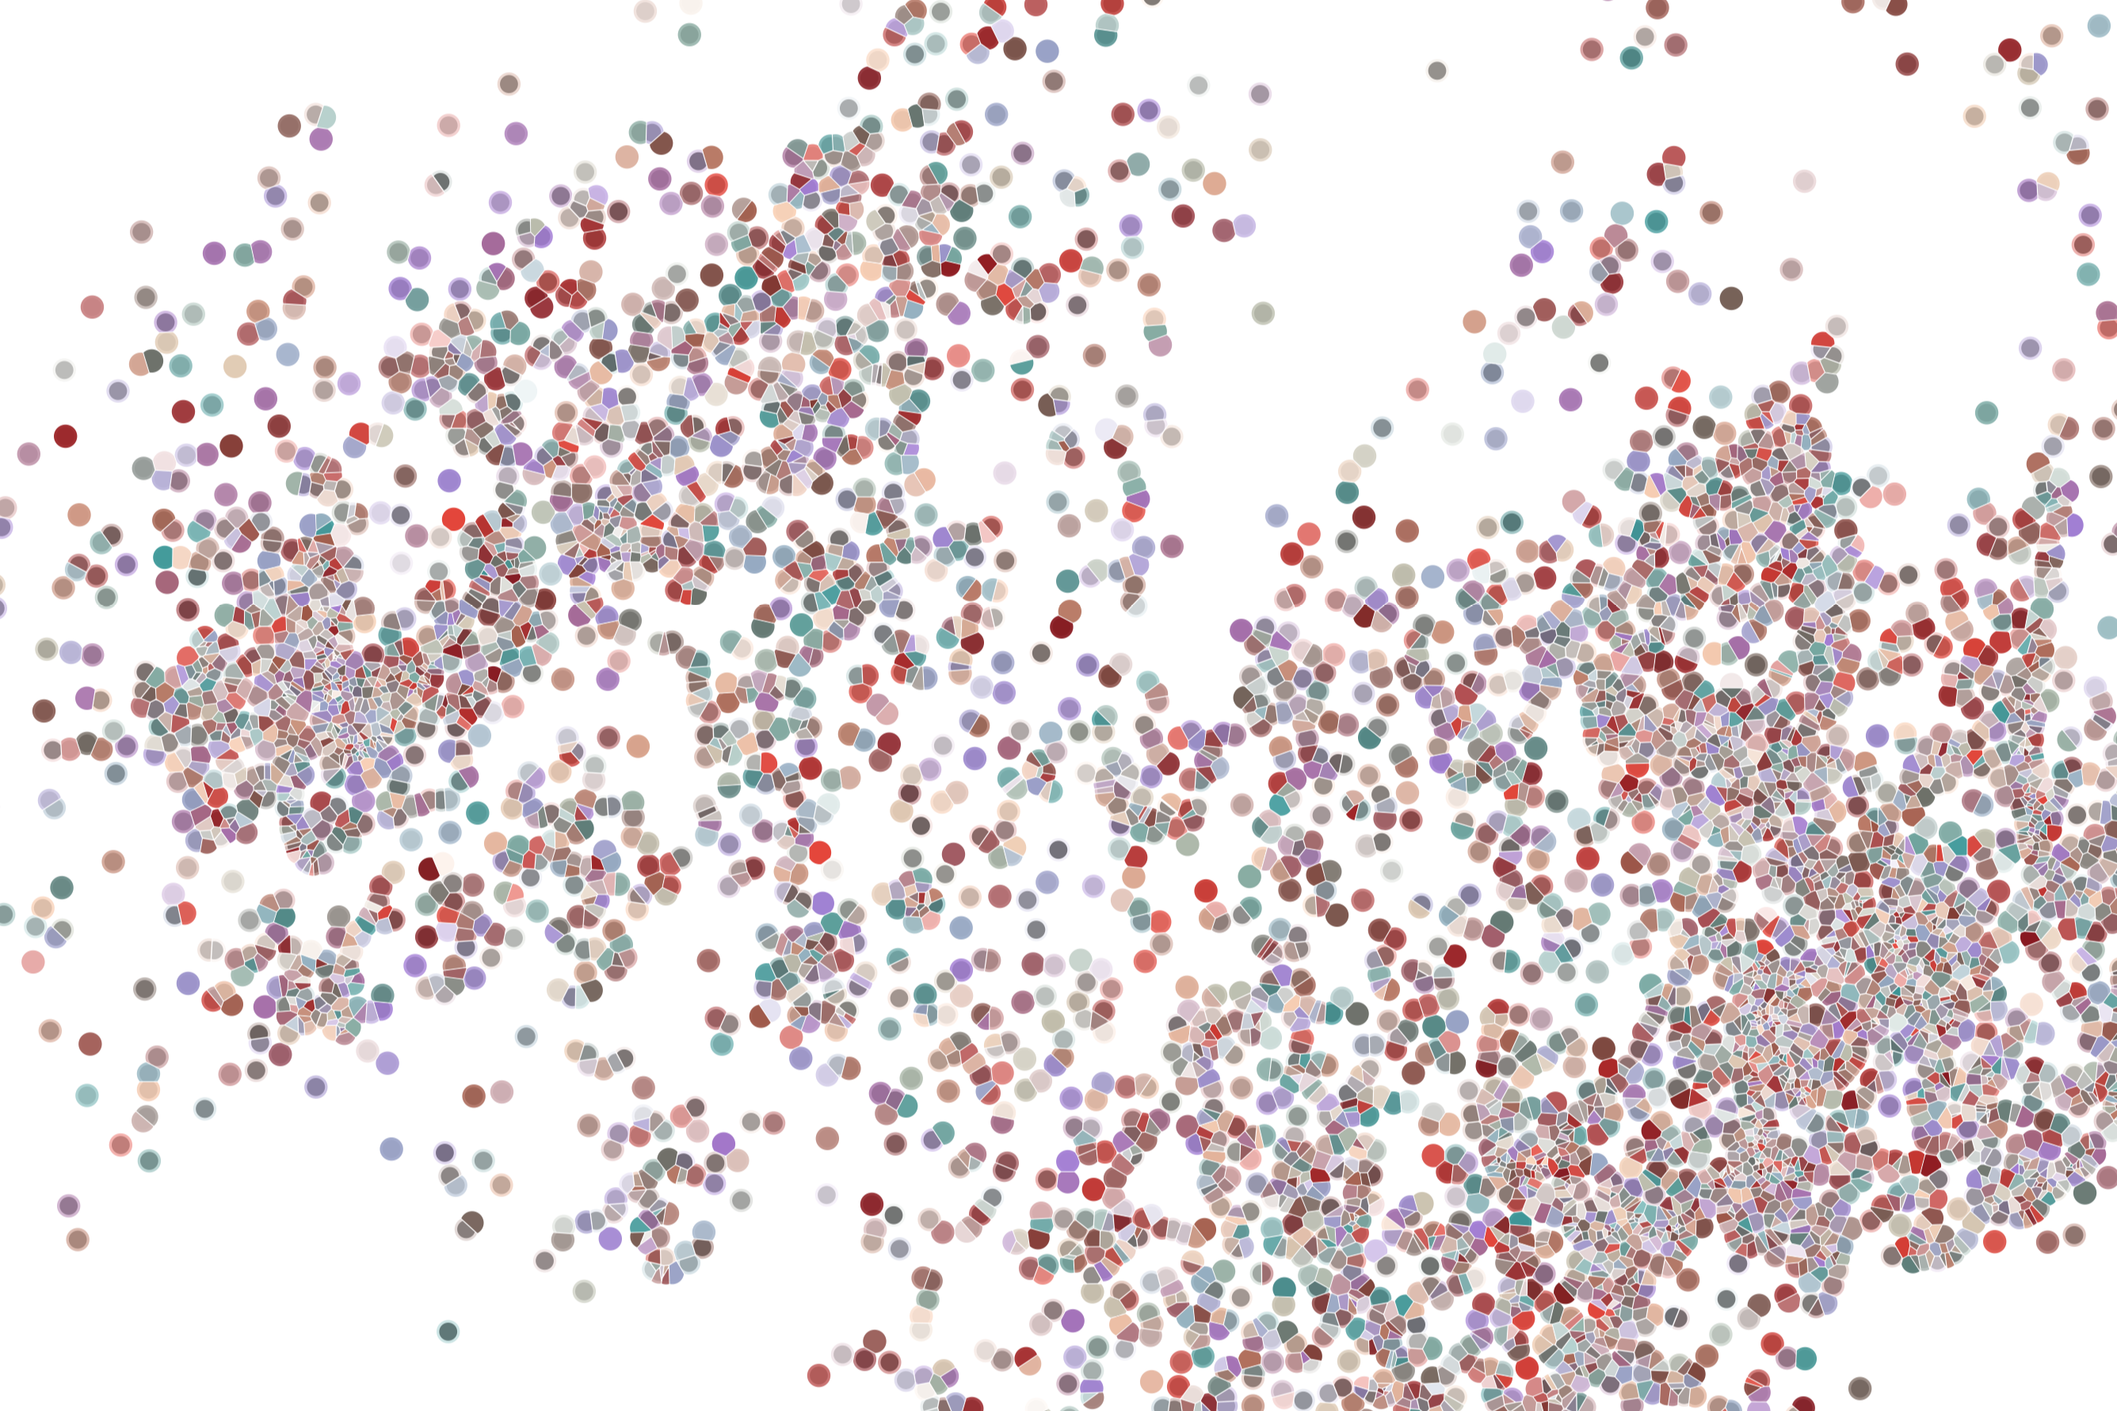
Lecture 4 Normalization of scRNAseq data
Physalia course 2021 — Single-cell RNA-seq with R/Bioconductor
Instructors: Jacques Serizay
Notes:
Hello everybody and thank you for attending my presentation. I am going to talk about the project I recently started working on in the Spassky and Koszul labs, both located in Paris. This project focuses on the unusual cooption of the mitotic machinery to drive, not cell division but cell differentiation.

Slide 2


Analysis workflow
Pre-Processing
Clustering
Biology
Expression Matrix
(GENES x CELLS)
1. Identify
Variable Genes
5. Differentially Expressed Genes
Filter Cells /
Quality Control
2. Dimensionality Reduction
6. Assigning
Cell Type
Normalization
3. Clustering
7. Functional Annotation
4. Explore (known)
marker genes
Notes:
I would like to expand these observations to in vivo data. I also want to check what happens in terms of transcriptional dynamics in cells where Cyclin O, a key non-canonical cyclin involved in MCC diff., is knocked-out.

Slide 3
Analysis workflow
Pre-Processing
Clustering
Biology
Expression Matrix
(GENES x CELLS)
1. Identify
Variable Genes
5. Differentially Expressed Genes
Filter Cells /
Quality Control
2. Dimensionality Reduction
6. Assigning
Cell Type
Normalization
3. Clustering
7. Functional Annotation
4. Explore (known)
marker genes
Notes:
I would like to expand these observations to in vivo data. I also want to check what happens in terms of transcriptional dynamics in cells where Cyclin O, a key non-canonical cyclin involved in MCC diff., is knocked-out.

Slide 4
Analysis workflow
Pre-Processing
Clustering
Biology
Expression Matrix
(GENES x CELLS)
1. Identify
Variable Genes
5. Differentially Expressed Genes
Filter Cells /
Quality Control
2. Dimensionality Reduction
6. Assigning
Cell Type
Normalization
3. Clustering
7. Functional Annotation
4. Explore (known)
marker genes
Notes:
I would like to expand these observations to in vivo data. I also want to check what happens in terms of transcriptional dynamics in cells where Cyclin O, a key non-canonical cyclin involved in MCC diff., is knocked-out.

Slide 5
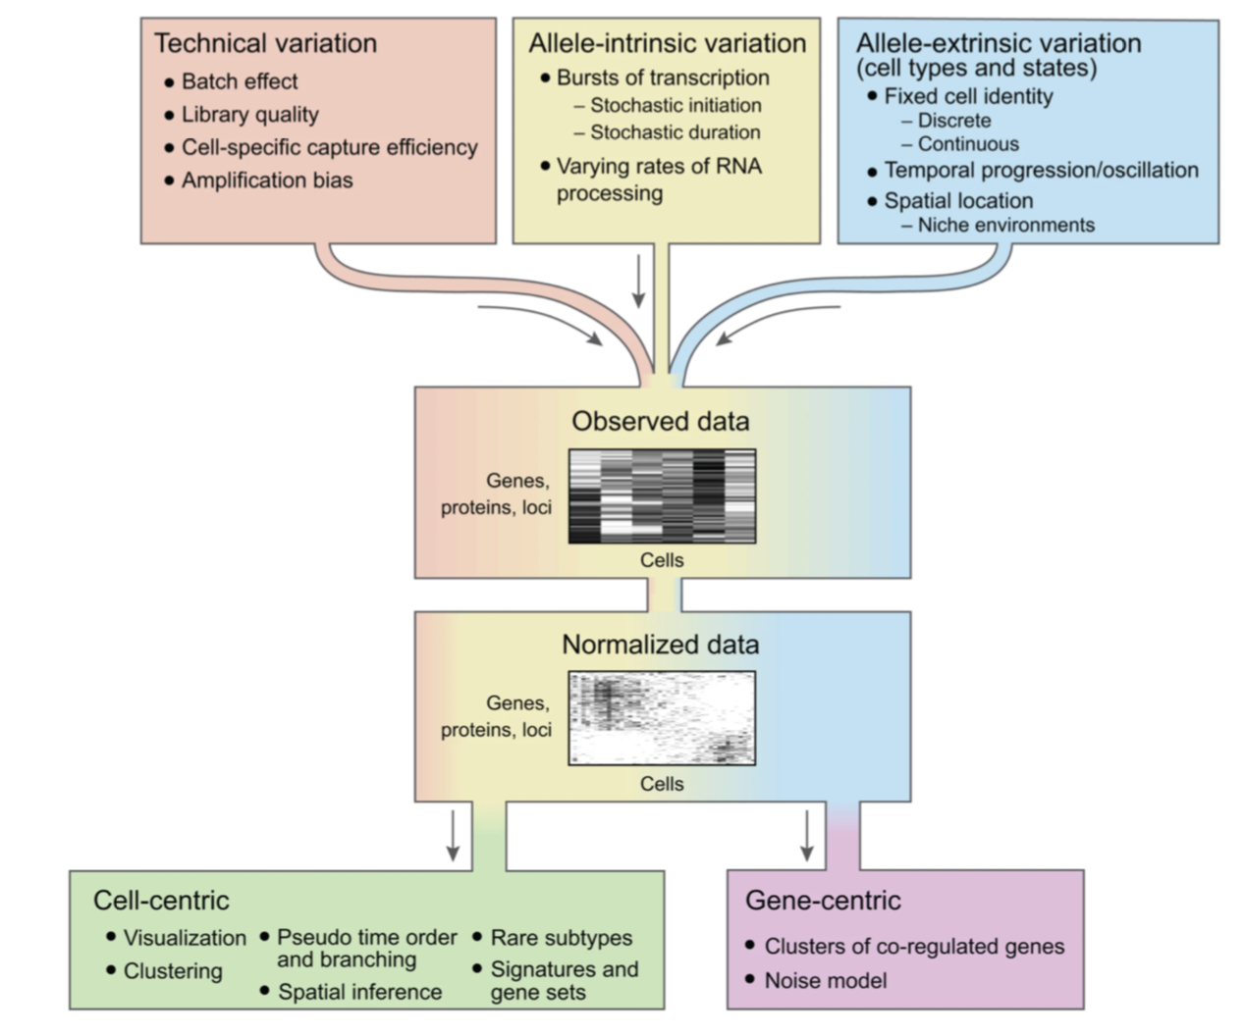
Sources of variations in gene expression
Wagner et al., Nat. Biotech 2016
5
Notes:
I would like to expand these observations to in vivo data. I also want to check what happens in terms of transcriptional dynamics in cells where Cyclin O, a key non-canonical cyclin involved in MCC diff., is knocked-out.

Slide 6
Sources of variations in gene expression
Normalization aims at removing technical variation.
In (single-cell) RNA-seq, the variance in gene expression depends on the level of expression of this gene:
A gene highly expressed will have a high variation of expression across cells.
6
Notes:
I would like to expand these observations to in vivo data. I also want to check what happens in terms of transcriptional dynamics in cells where Cyclin O, a key non-canonical cyclin involved in MCC diff., is knocked-out.

Slide 7
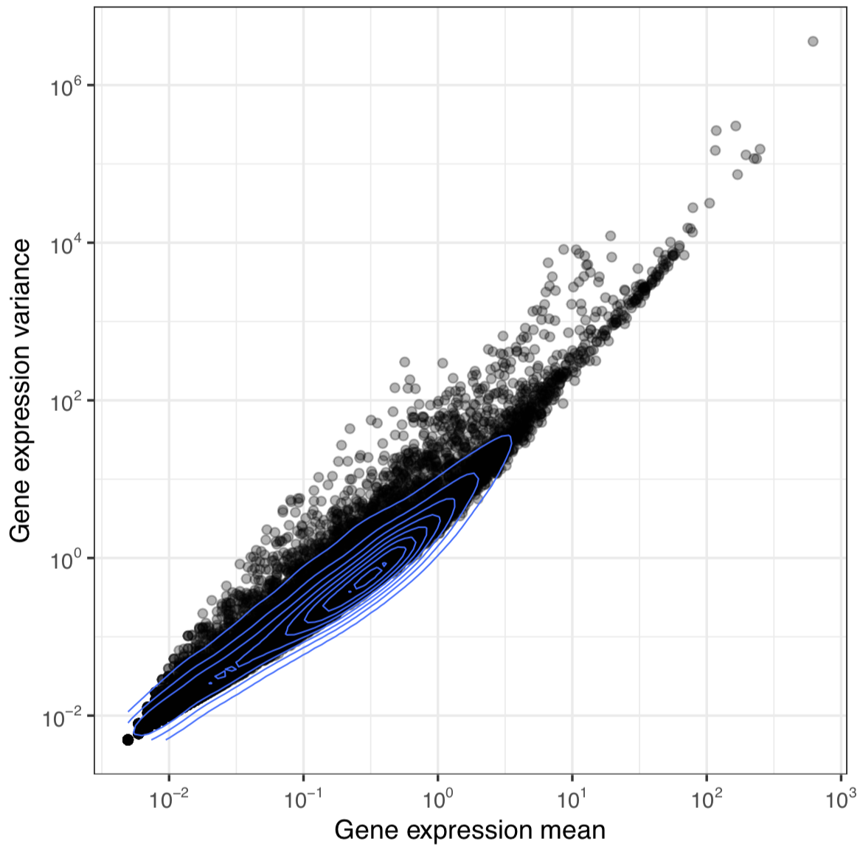
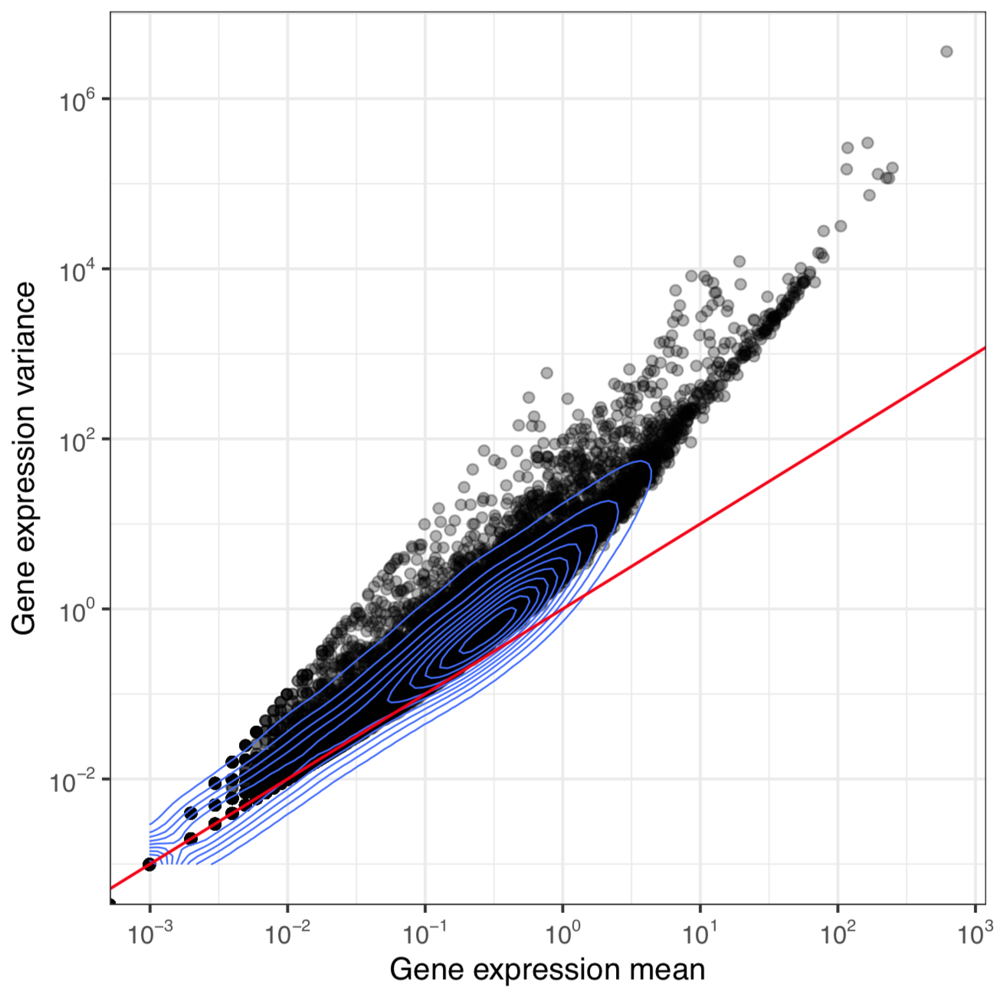
Sources of variations in gene expression
Normalization aims at removing technical variation.
7
Notes:
I would like to expand these observations to in vivo data. I also want to check what happens in terms of transcriptional dynamics in cells where Cyclin O, a key non-canonical cyclin involved in MCC diff., is knocked-out.

Slide 8
Sources of variations in gene expression
Normalization aims at removing technical variation.
In (single-cell) RNA-seq, the variance in gene expression depends on the level of expression of this gene:
A gene highly expressed will have a high variation of expression across cells.
Poisson distribution is generally viewed as a good way to model counts, such as those in a scRNAseq count matrix.
According to Poisson distribution, the variation of counts is equal to the mean of the counts.
8
Notes:
I would like to expand these observations to in vivo data. I also want to check what happens in terms of transcriptional dynamics in cells where Cyclin O, a key non-canonical cyclin involved in MCC diff., is knocked-out.

Slide 9
Sources of variations in gene expression
Normalization aims at removing technical variation.
9
Notes:
I would like to expand these observations to in vivo data. I also want to check what happens in terms of transcriptional dynamics in cells where Cyclin O, a key non-canonical cyclin involved in MCC diff., is knocked-out.

Slide 10
Sources of variations in gene expression
Normalization aims at removing technical variation.
In (single-cell) RNA-seq, the variance in gene expression depends on the level of expression of this gene:
A gene highly expressed will have a high variation of expression across cells.
Poisson distribution is generally viewed as a good way to model counts, such as those in a scRNAseq count matrix.
According to Poisson distribution, the variation of counts is equal to the mean of the counts.
Deviation from this Poisson distribution is considered to be due to technical variations.
10
Notes:
I would like to expand these observations to in vivo data. I also want to check what happens in terms of transcriptional dynamics in cells where Cyclin O, a key non-canonical cyclin involved in MCC diff., is knocked-out.

Slide 11
VST: Variance stabilizing transform
VST attempts to stabilize the variance to the mean gene expression
11
Notes:
I would like to expand these observations to in vivo data. I also want to check what happens in terms of transcriptional dynamics in cells where Cyclin O, a key non-canonical cyclin involved in MCC diff., is knocked-out.

Slide 12
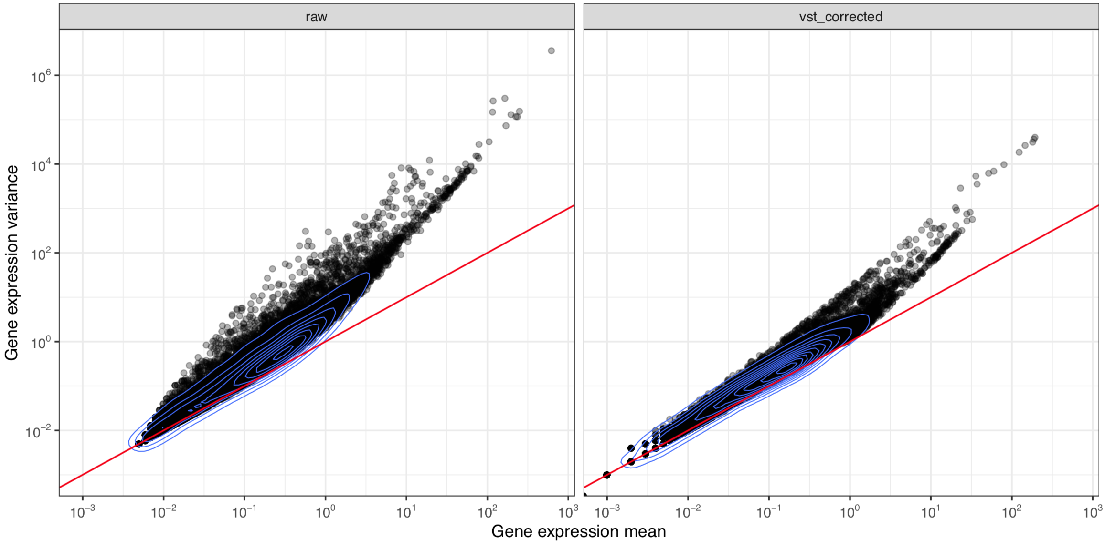
VST: Variance stabilizing transform
VST attempts to stabilize the variance to the mean gene expression
12
Notes:
I would like to expand these observations to in vivo data. I also want to check what happens in terms of transcriptional dynamics in cells where Cyclin O, a key non-canonical cyclin involved in MCC diff., is knocked-out.

Slide 13
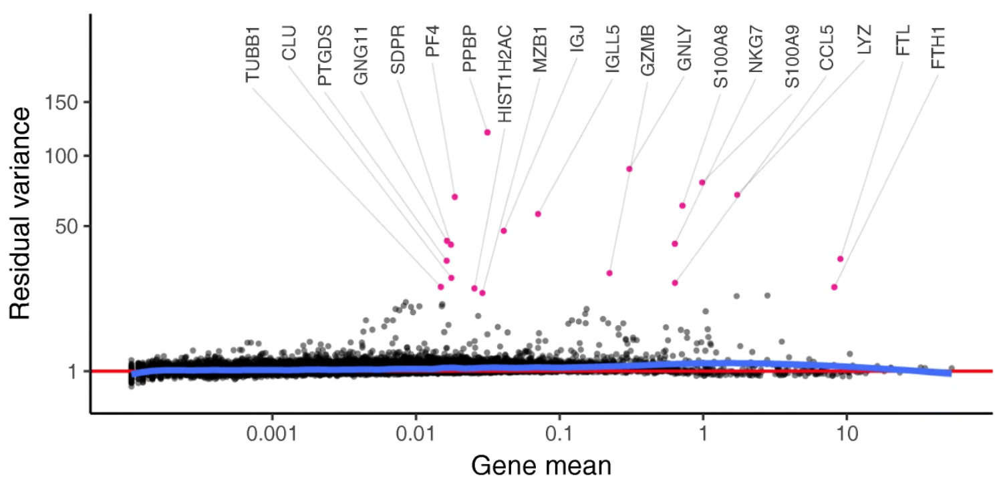
VST: Variance stabilizing transform
The variance residuals computed from fitting a regularized Negative Binomial distribution to variance ~ mean can be used to identify highly variable genes.
Hafemeister & Sajita, Genome Biology 2019
13
Notes:
I would like to expand these observations to in vivo data. I also want to check what happens in terms of transcriptional dynamics in cells where Cyclin O, a key non-canonical cyclin involved in MCC diff., is knocked-out.

Slide 14
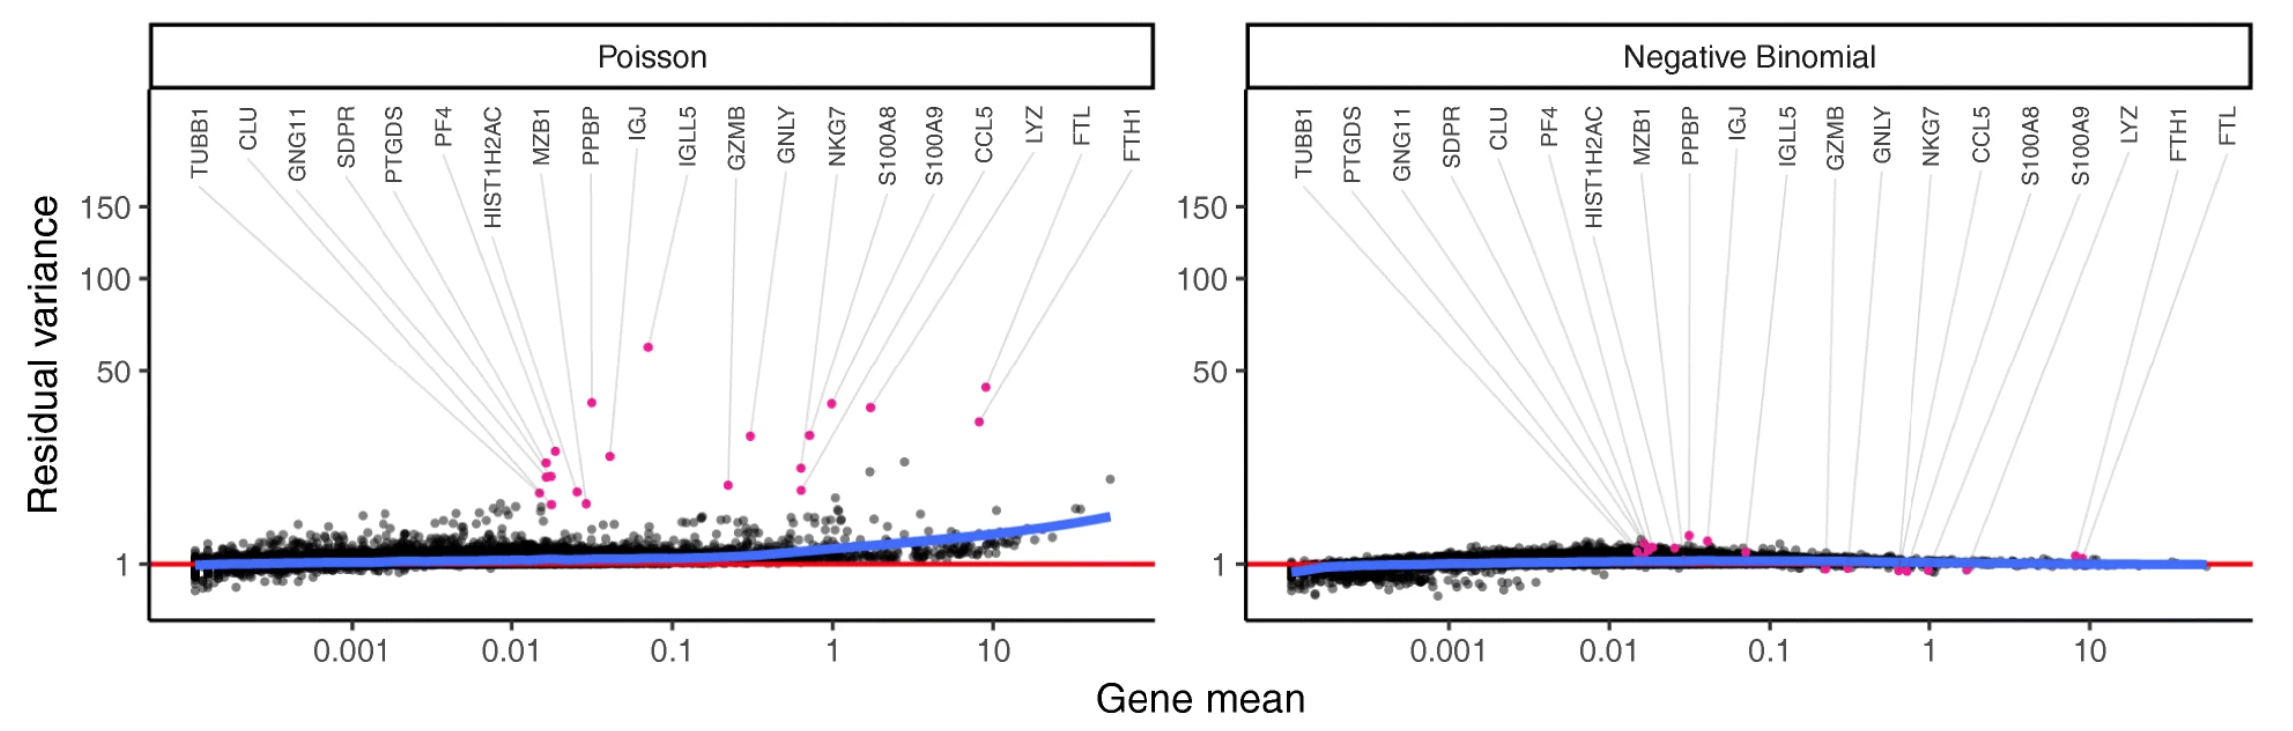
VST: Variance stabilizing transform
A regularized Negative Binomial distribution is a tentative middle-ground between two extremes: the Negative Binomial distribution or the Poisson distribution.
Regularized negative binomial
Hafemeister & Sajita, Genome Biology 2019
14
Notes:
I would like to expand these observations to in vivo data. I also want to check what happens in terms of transcriptional dynamics in cells where Cyclin O, a key non-canonical cyclin involved in MCC diff., is knocked-out.

Slide 15
Sources of variations in gene expression
Normalization aims at removing technical variation.
In practice, normalization accuracy is not such a major consideration for exploratory scRNA- seq data analyses.
Composition biases do not usually affect the separation of clusters, only the magnitude.
15
Notes:
I would like to expand these observations to in vivo data. I also want to check what happens in terms of transcriptional dynamics in cells where Cyclin O, a key non-canonical cyclin involved in MCC diff., is knocked-out.

